Slide 1
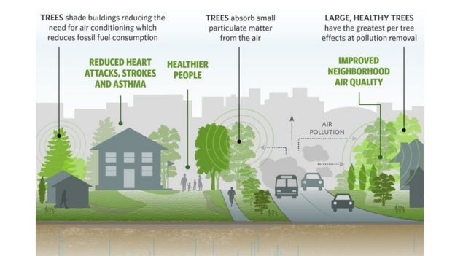
Problem Statement
With the modernization of the world, the number of trees across the globe has decreased exponentially during this century.
There are several effects like erosion, pollution, global warming and climatic changes to name few of them as a result of deforestation.
With a motive to encourage “Afforestation”, we have developed a bidding application to encourage climate associated NGOs to come forward and bid for the growing and adopting of trees across different locations of India.

Slide 2
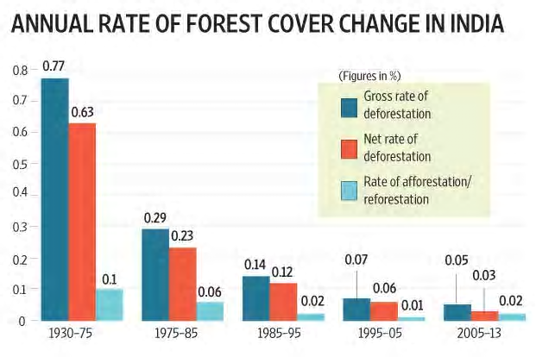

Slide 3
Be wise, Let the greenery rise!
What’s your Value Proposition:
Promoting afforestation.
Single platform(government) for all the NGOs to bid for planting and adopting trees.
Data points:
For the tender amount, government will get funds from various sources like financial institutions, CSR, private organizations, climate support tax etc.

Slide 4
How our model works?
This bidding application is a unique blend of technology and process with very easy to understand User Interface.
This application will be very useful for Government authorities or regulatory bodies which deals in tree plantation and its management but want to outsource this task to NGOs.
In normal biddings, main concern is of corruption which includes allocating the tenders or passing confidential information to known entities. This application will be using computer engines to perform all such tasks hence human related both intentional and unintentional errors will be taken care.
Since this is an online platform so it will be very much convenient for NGOs to place their bid in very less time.

Slide 5
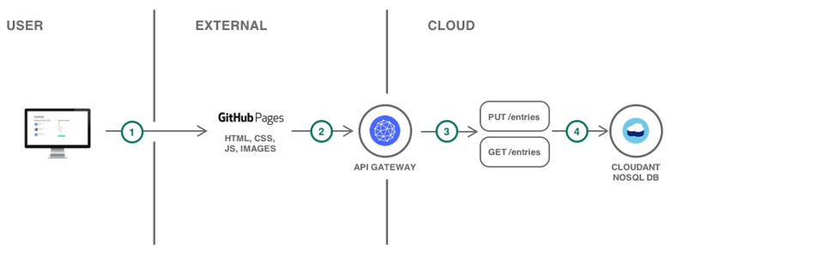
Architecture

Slide 6
Future scope
Application has lots of manual work and manual hand off at the moment, all of this can be automated so that application is itself able to track collection of funds, create proposals across locations, gathering of submissions/bidding by NGOs and then allocation of funds to NGOs for plantation
Application can be configured with rule management system of ease of changes and maintenance
Application can further be enhanced to track usage of funds to actually created a video/image gallery which can be used to govern how it’s helping the growth of trees across location
Transparency, automated, no corruption/manual hand-off

